Slide 1

FetchApp
Ridesharing App for iOS
Jonathan Tan, Brian Taube, Paulo Patulandong, Virgilio Garcia, Anthony Martinez

Slide 2

FetchApp
Ridesharing App for iOS
Social Media
Tracks Mileage

Slide 3

Target Demographics
College Students and Young Adults
Small Business

Slide 4




Development
Waterfall Life Cycle

Slide 5
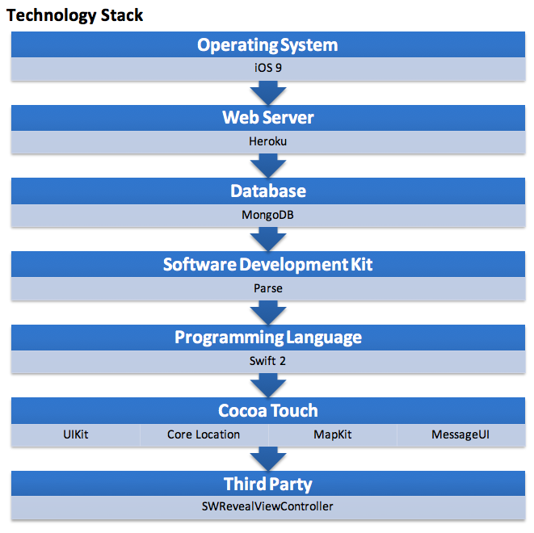

Slide 6

Features
User Accounts
Friend’s Lists
Friend Groups
Business Groups
Rankings
Mileage Tracker
Location Tracing

Slide 7
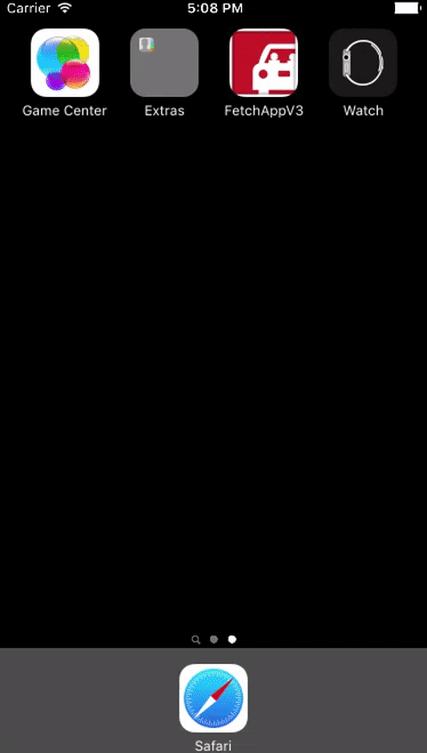
Startup
AppIcon taken from Google –http://www.dal.ca/dept/sustainability/smart-trip/ride-sharing.html

Slide 8
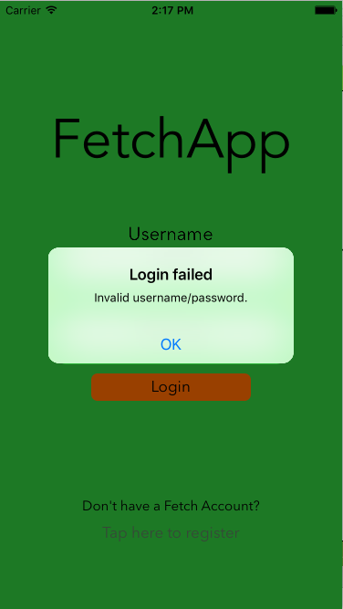
Login
Verification

Slide 9
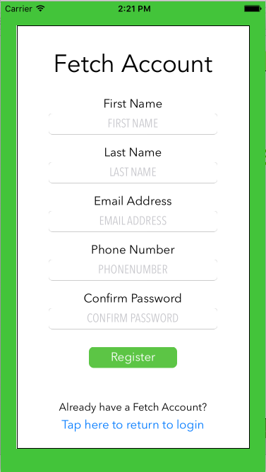
Register
Register account directly from app

Slide 10
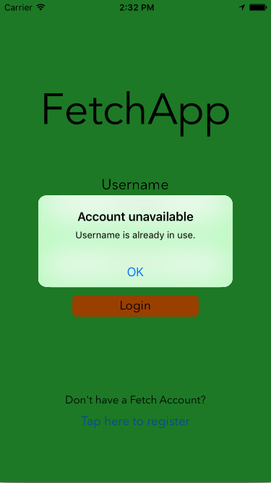
Register
Verification

Slide 11
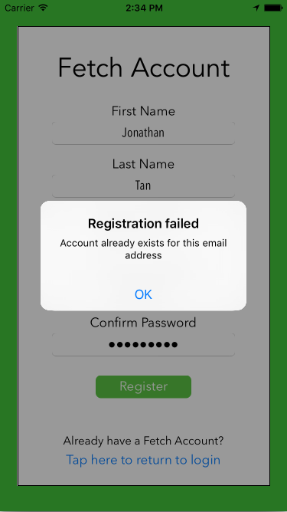
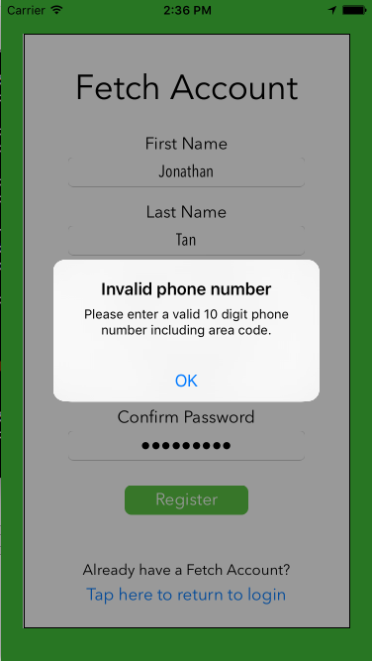

Slide 12
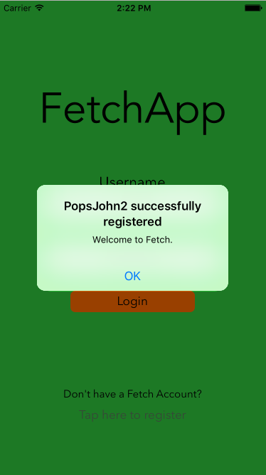
Register
Success registration

Slide 13
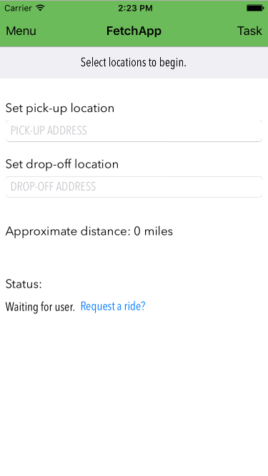
Main Screen

Slide 14
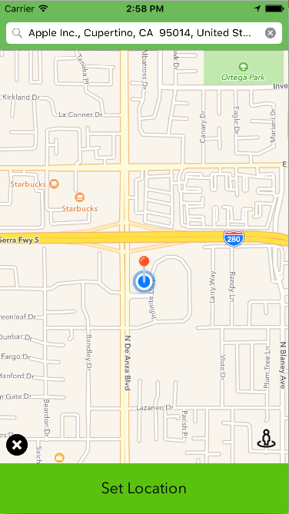
Set location
Selection by
Map pan
Address search
Reset map button

Slide 15
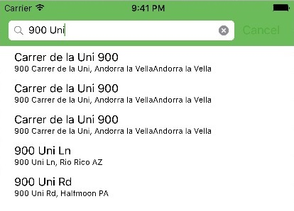
Set Location
Autofill location search

Slide 16
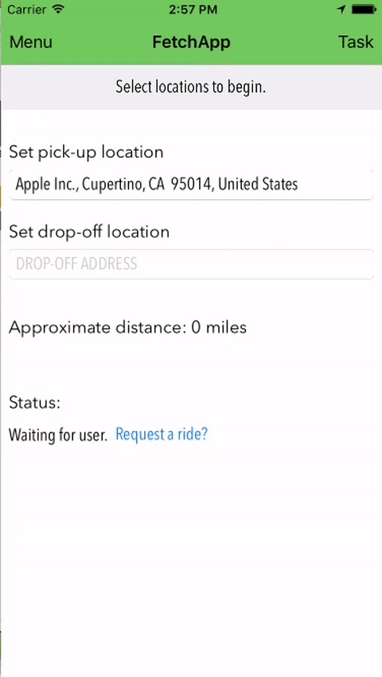

Slide 17
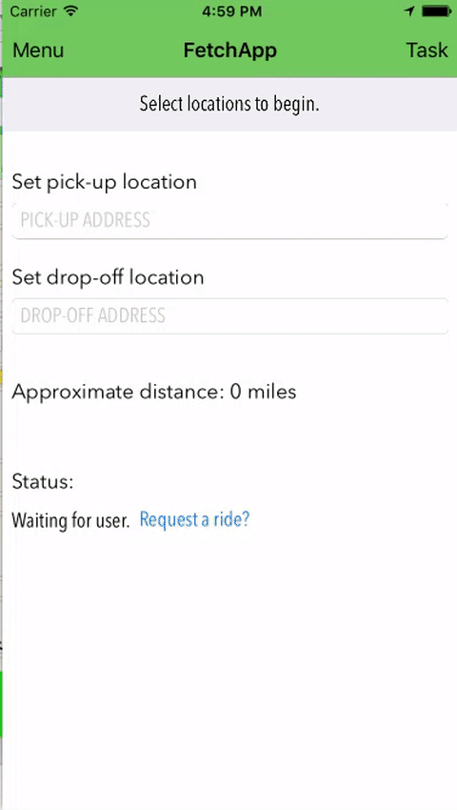

Slide 18
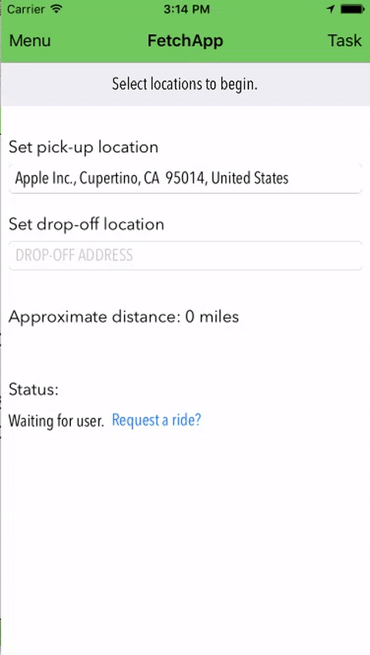
Task
Provides quick access to current task
Address selection opens Apple Maps for navigation

Slide 19
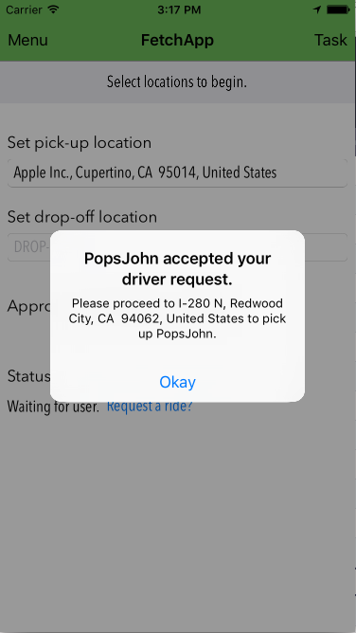

Slide 20
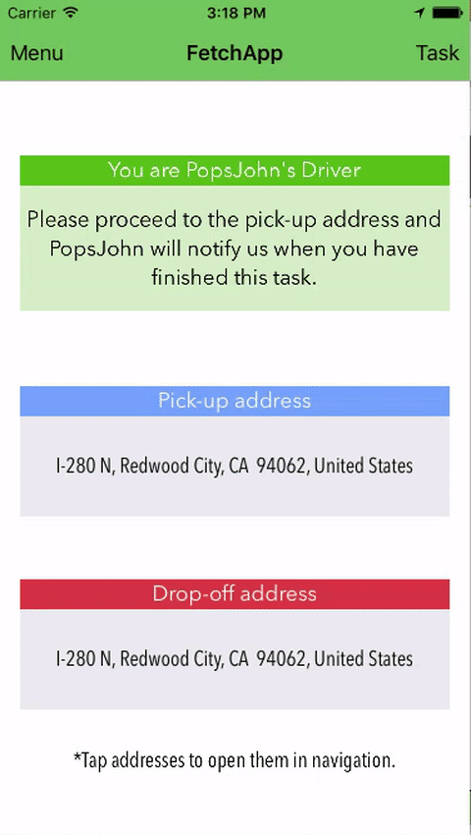

Slide 21
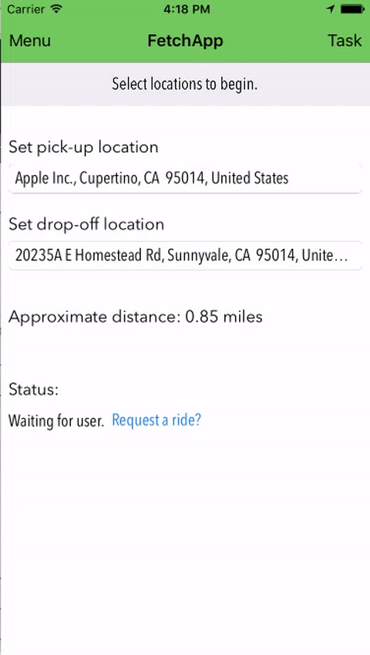
Function
Request Ride
Wait for friends to respond

Slide 22
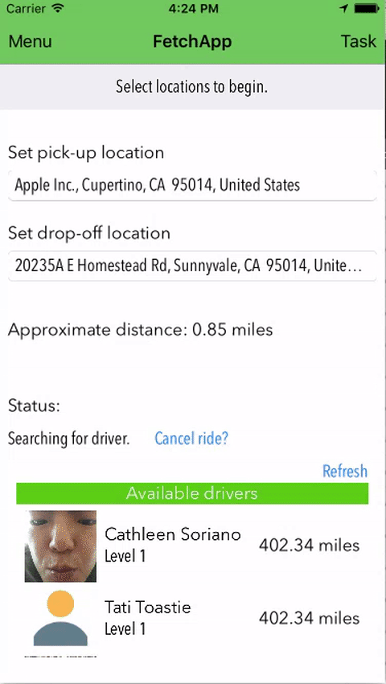
Function
Select driver

Slide 23
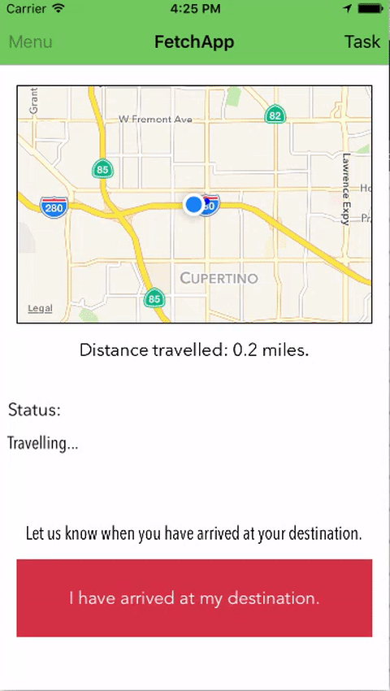
Function
Track user and record miles
Add recorded miles to driver’s profile as “experience” points

Slide 24
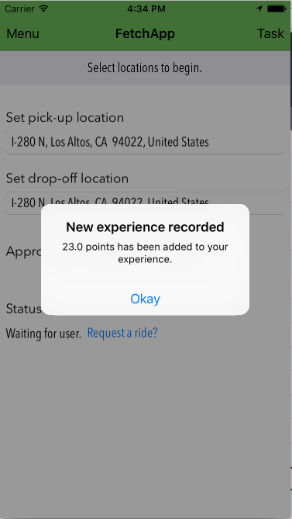

Slide 25
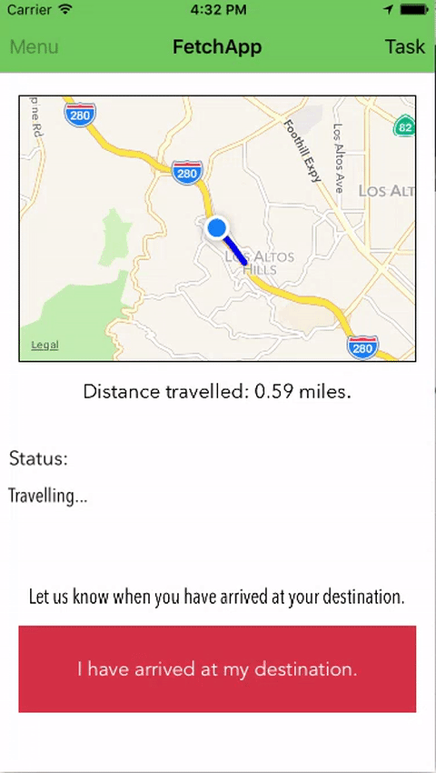
Mile Tracking
Tracks user while travelling
Marks map with a polyline and calculates distance travelled

Slide 26
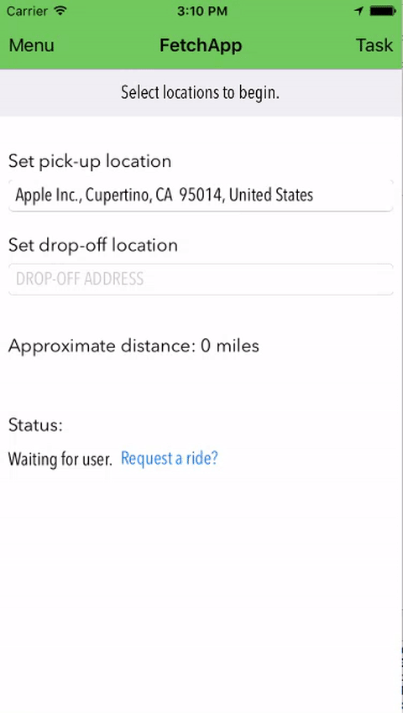
Menu
Quick access to
all features

Slide 27

Friend’s List
Custom groups
Status indicators
Friend profiles
Authentication

Slide 28



Slide 29


Slide 30
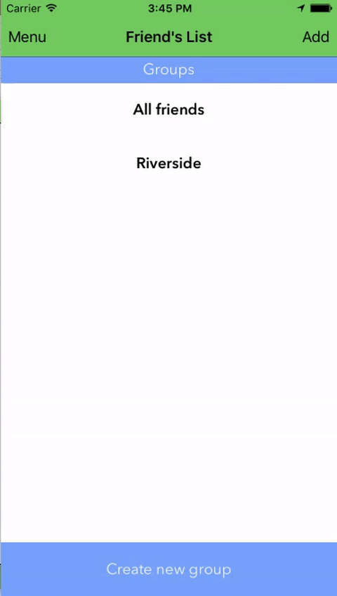
Groups
Custom identifiers
Authentication

Slide 31

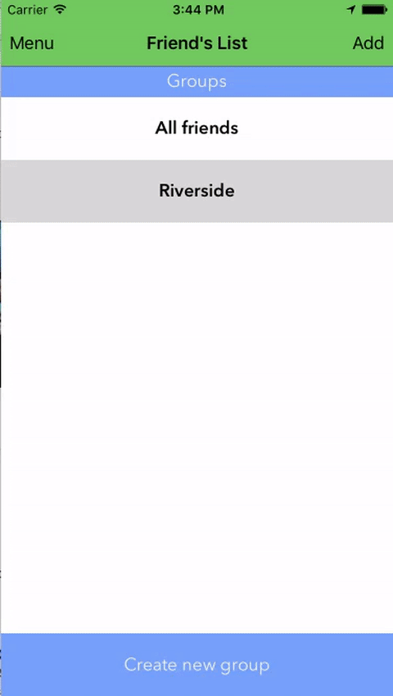

Slide 32

Business
Custom business groups
Employee notification
Authentication

Slide 33
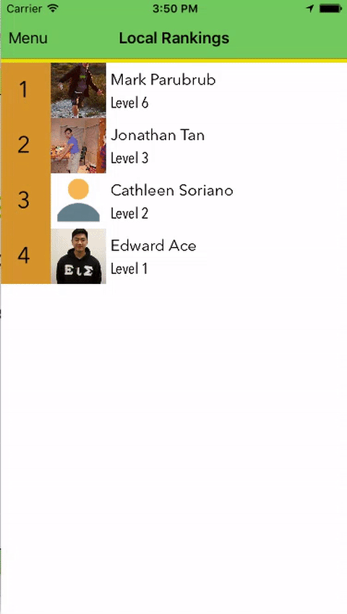
Rankings
Ranks user and friends by level and experience

Slide 34
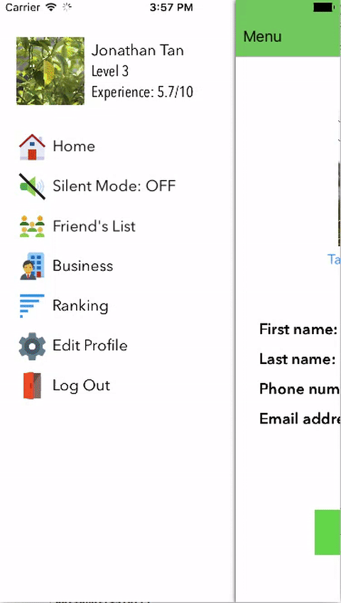
Edit Profile
Change user’s profile and update database

Slide 35
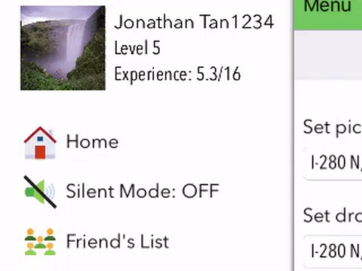
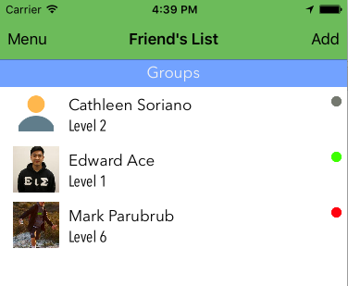
Silent Mode
Green – Available
Red – Requesting ride
Grey – Unavailabe
Set status
On – Green
Available
Off – Grey
Un-available

Slide 36
Did not implement
Push notifications – requires Apple developer account

Slide 37
The End

